Slide 1
Week CIS 215
CERT/CSIRT

Slide 2
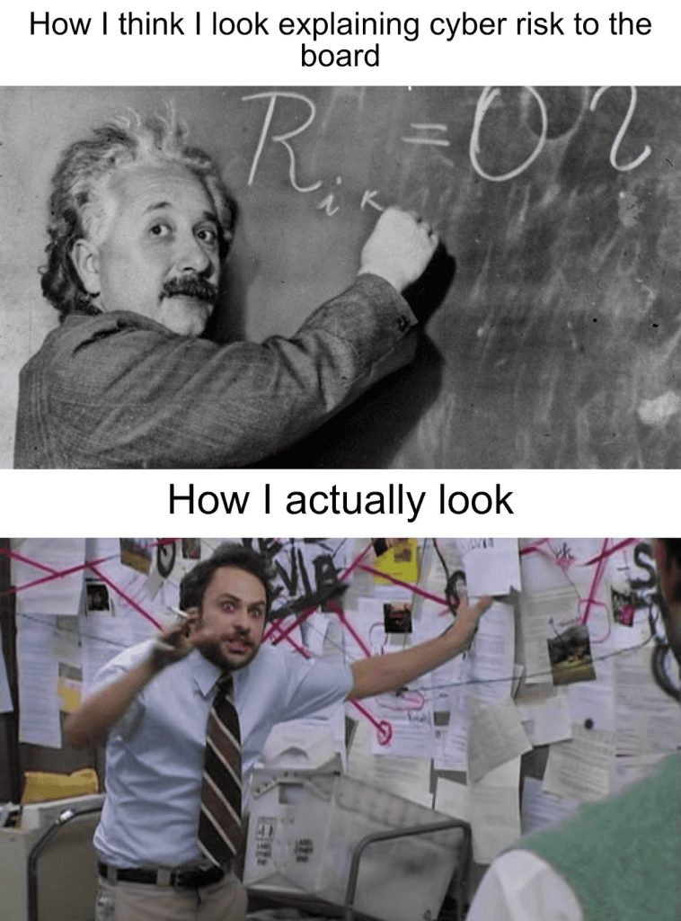
What is a CERT/CSIRT?
Computer Emergency Response Team
Computer Security Incident Response Team
Went from CERT to CSIRT to panic people less
Technically there is also a US patent on CERT
CSIRT is usually housed/run by the SOC (Security Operations Center)

Slide 3

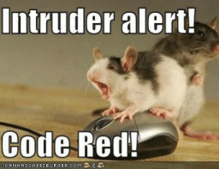
National CSIRT
There are national CSIRT terms
US-CERT run by DHS (the Cyber Security Division)
CERT-CC combo of DARPA and Carnegie Mellon
FIRST Forum of Incident Response and Security Teams
Global association of CSIRTs
Not every country is a part of FIRST

Slide 4

More Local CSIRT
Companies need them
Every company no matter how small should have a plan
A plan that everyone talks about and agrees to BEFORE the emergency/incident.
People who are panicked are not rational

Slide 5
SOC
Security Operations Center
Larger companies might have a CSIRT and a SOC.
Smaller companies with dedicated IT might have only a NOC (Network Operations Center) that does double duty as a SOC
A SOC is for detection, containment and remediation of threats will happen.
A SOC is created when there is a lot of sensitive data is being handled, or because of industry or government that says you need one.
Some SOCs are 24/7 some are regular 9-5, some have on call options, totally dependent on the company and its needs
Government branches will generally have a SOC because of the threats they deal with

Slide 6
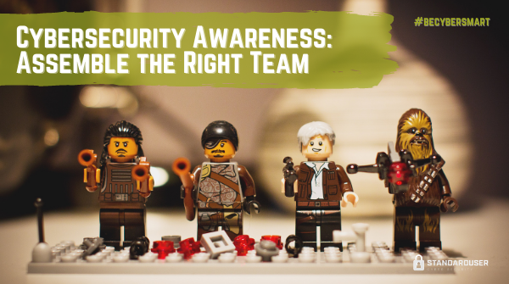
How to decide who's on a CSIRT?
You need people from ALL parts of the company
C-Suite (A.K.A. authority to make the tough calls)
IT
Sales
Accounting and Finance
If you don't have someone on the team to speak to what each group does, the tools they need, and the planning they have things will be missed
If you don't work in accounting, are you going to remember to take into account Tax accounts? maybe. But what about Accounts payable and receivable? Assets? What software does everyone use? Version? Etc...

Slide 7
Communication within the CSIRT
Need backup communication. If the company servers are down relying on company email and VoIP isn't going to go well in an emergency
Outsourced servers
Phones
Outside email
Everything needs to be updated.
Is everyone on the team still working for the company? In the same role? Are we missing any departments? Are we missing any new info or situations that have changed?

Slide 8
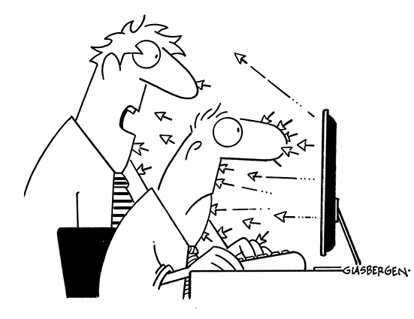
Planning using the CSIRT
Everyone talks and agrees what should be done in the event of an emergency
As much as possible is planned out
Regular meetings are needed
Both for planning, but also because you need to trust your team. Trust they are doing their part. That goes better when you know them
Checklists are the best way to plan, don't assume logical thoughts in an emergency

Slide 9
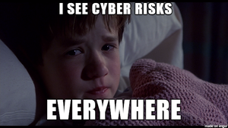
Things to think about
What assets does the company have?
Threat assessment
including risk assessment of the company
Public statements (
can you pre-write these?
Have several ready to go just in case
What is your backup plan?
Disaster Recovery is next week
What logs are you keeping? For how long? When do you go through them?
What information is shared when? (legal disclosure obligations)
Do you tell the whole company when an incident happened? Just some? If some, then who? When do you share with shareholders?

Slide 10

Activity
In small groups, discuss what's missing from my things to think about list. What else might a company need to consider when planning for an incident?

Slide 11
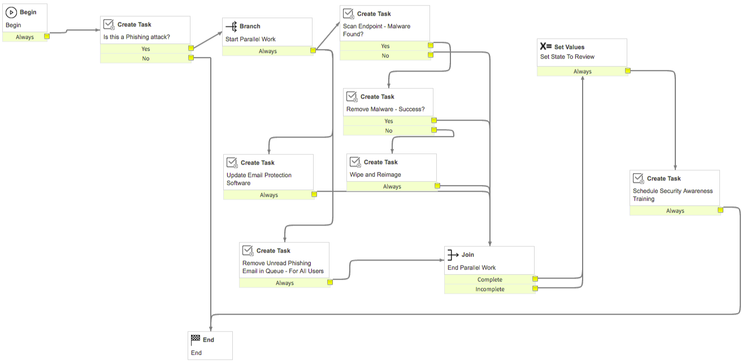
Checklists example (More are in the module)

Slide 12

TEST
For the love of all things TEST TEST TEST
Everything will go wrong. You don't know there's an issue until you test
Don't aim for perfect. Aim to do better than last year
Schedule REGULAR tests.
Yes other things are on fire and important. BUT if you don't have a plan for incident response, fires can be mild in comparison so what happens
Did I mention TEST TEST TEST?

Slide 13

TEST

